Slide 1


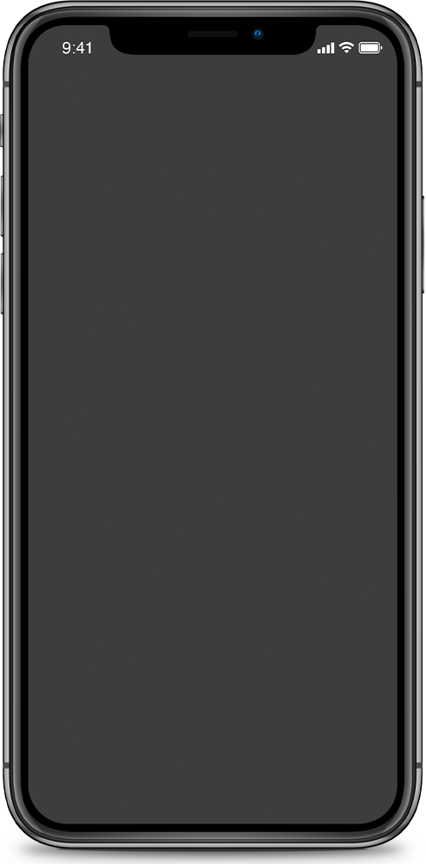
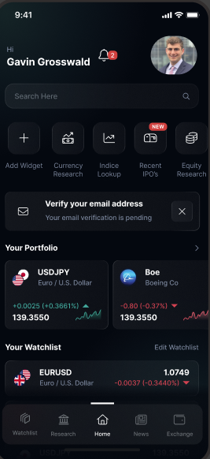

TRADE GENIUS
A market research firm.
Focused on democratizing finance.
IST 659 - Team 1
Cheromaine Nisa Ornella Smith
Ivan Ovalle
Gavin Grosswald
Nick Yurashku

Slide 2

TOPICS COVERED
TOPIC 1: OVERVIEW
TOPIC 2: DATA MODELS
AGENDA
TOPIC 3: APP MOCK UP
TOPIC 4: CONCLUSIONS

Slide 3


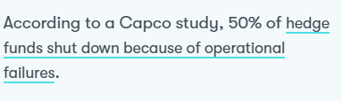

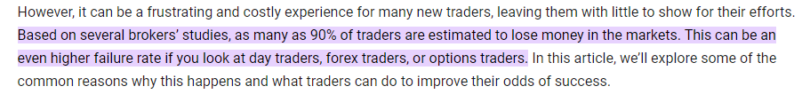

38% OF HEDGE FUNDS FAIL
Due to bad investment decisions
AND
90%
of retail traders fail to make a profit trading
TradeGenius’ believes that the lack of high quality information for CTA’s and retail traders is what keeps many from succeeding

Slide 4
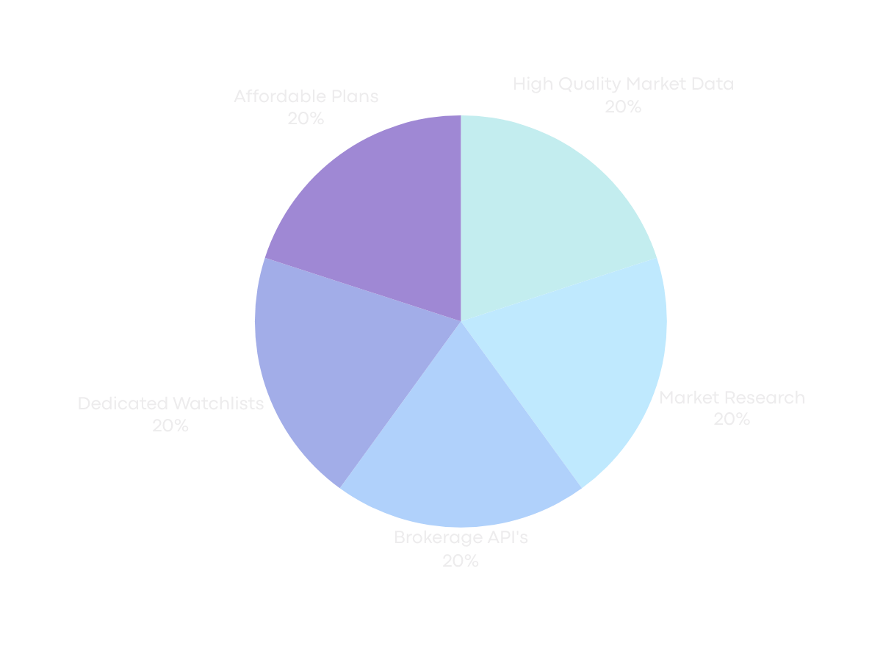
OVERVIEW
TradeGenius is focused on improving the financial world by providing high quality and obtainable financial research to users that wish to be informed of what the market is doing.

Slide 5
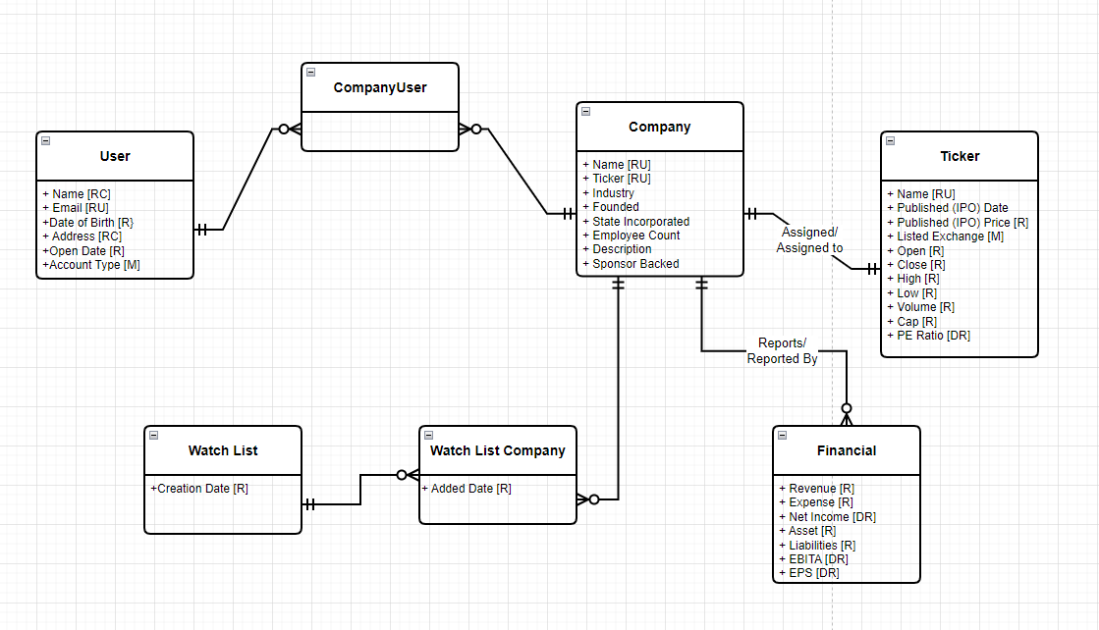
Conceptual Data Model

Slide 6
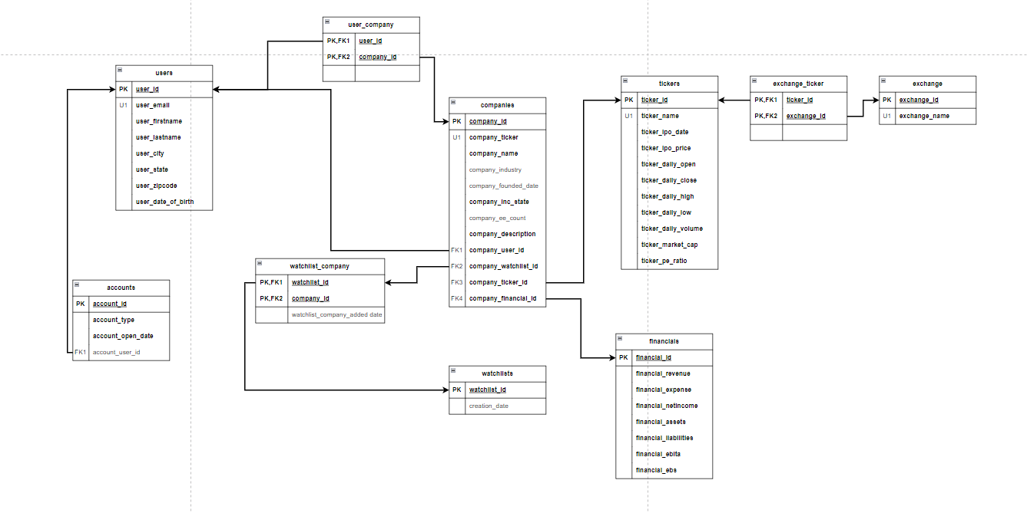
PHYSICAL DATA MODEL

Slide 7
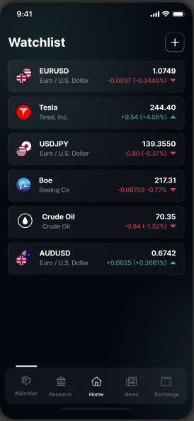
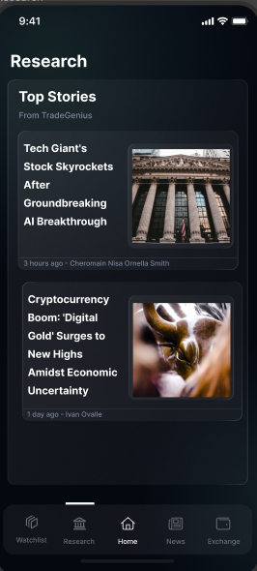
DASHBOARD
Homepage
Watchlists
Research
A simple customizable dashboard for users
Customizable watchlists
Research at your fingertips

Slide 8
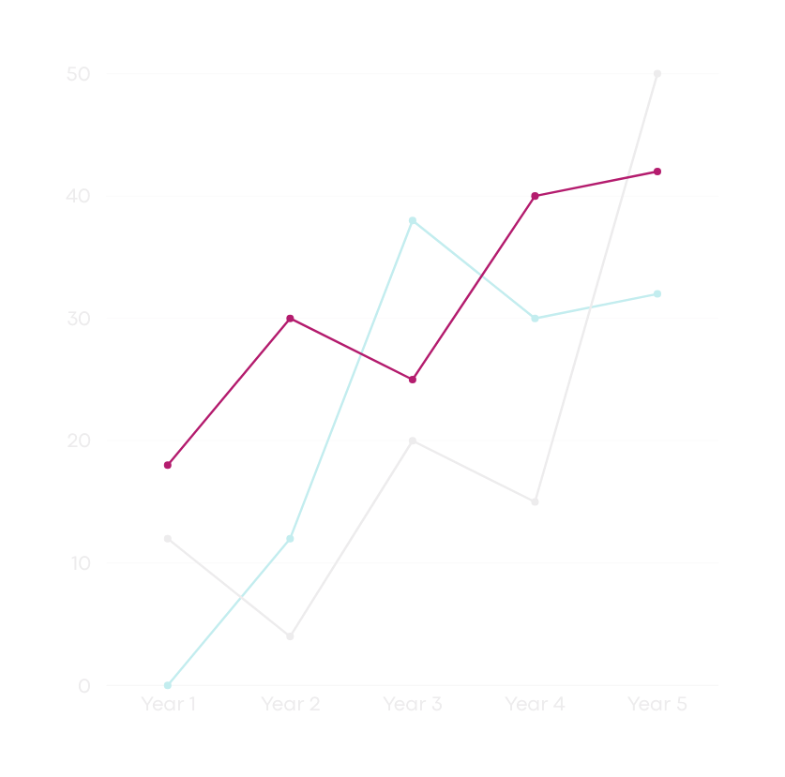
CONCLUSIONS
TradeGenius will be an app that helps traders make investment decisions based on top tier research, in all, improving investment results and lowering risk of failure.

Slide 9
ROLLOUT STRATEGY
Protype App
Find Investors
IPO
Progress
Team will focus on rolling out a prototype app that users can provide feedback on.
Securing several rounds of investment in order to eventually offer the app to the public for investing.
Continue to be the pinacle of success for democratizing financial research.
Founders will attend pitch competitions to find funding from VC’s.

